Slide 1
Eco-Schools

Slide 2
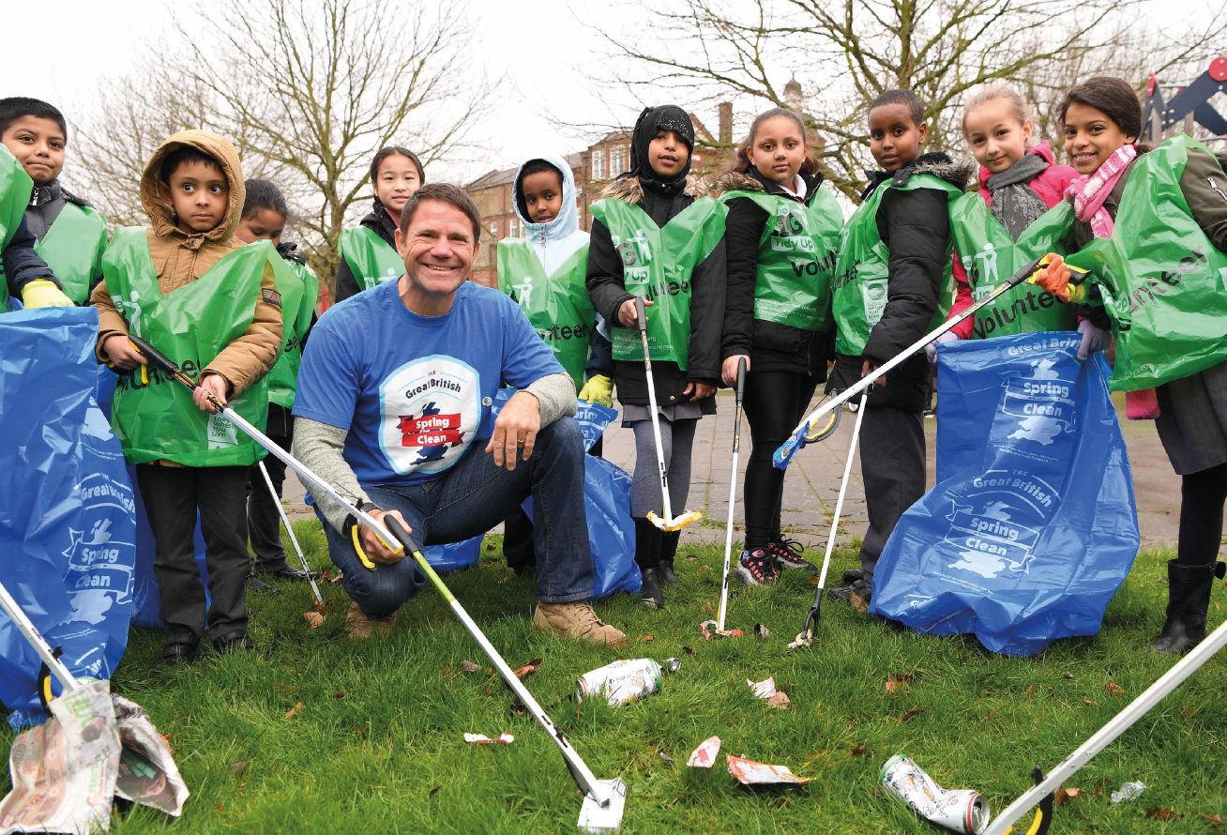

Slide 3
Does anyone recognise this?

Slide 5
Eco-Schools focus on ten topics.
Can you guess what they are?

Slide 6
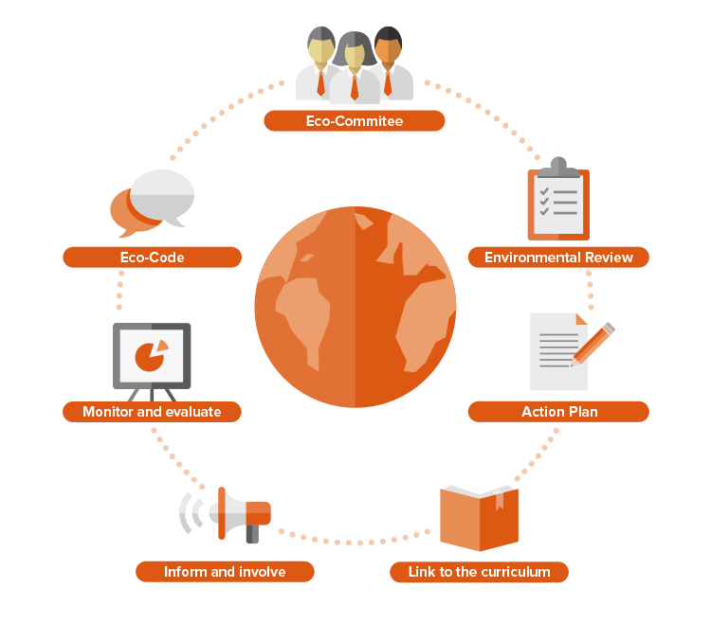

Slide 7
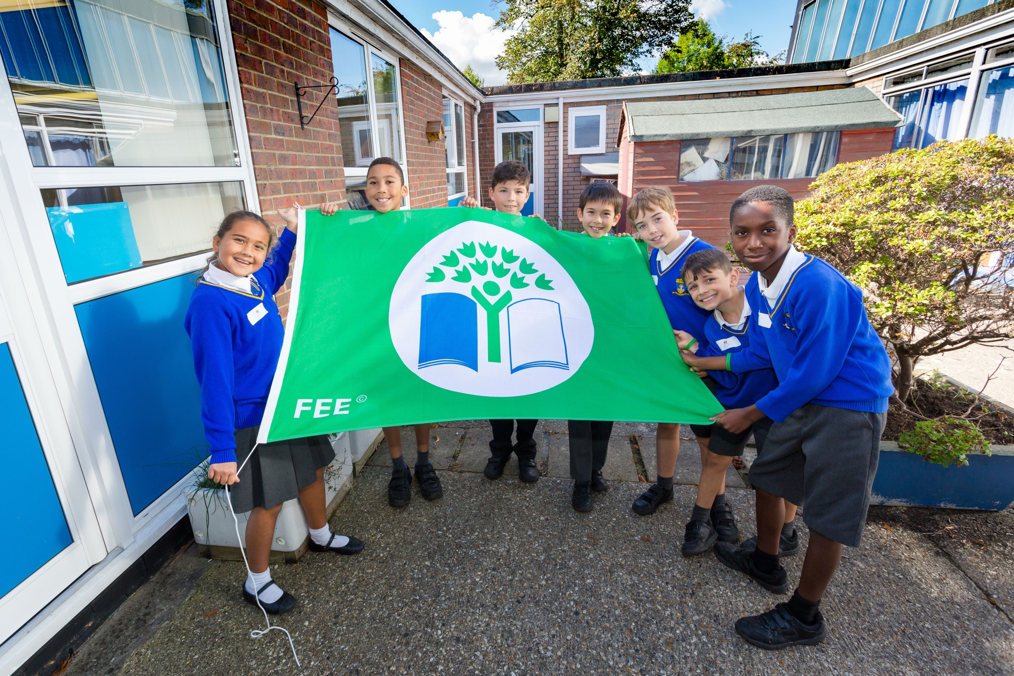

Slide 8
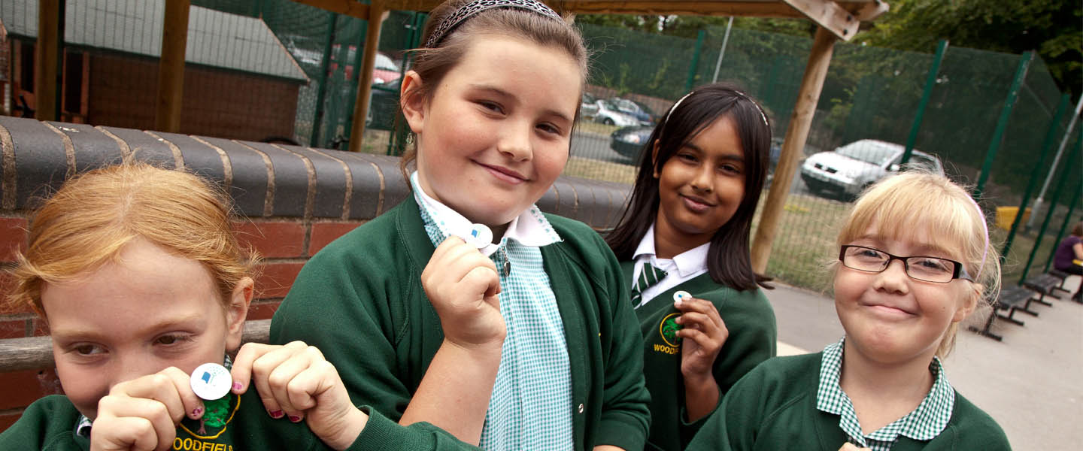
What do we need to do next?

